Slide 1
Nuclear Fuel Performance
NE-591-010
Spring 2021

Slide 2
Housekeeping
Will be posting an optional assignment
If completed will count as 10% of your total grade, and other assignments will be adjusted uniformly
Details will be including within the post, but will be a written report, due April 22
Graded exams will be emailed out later today

Slide 3
Fission products

Slide 4
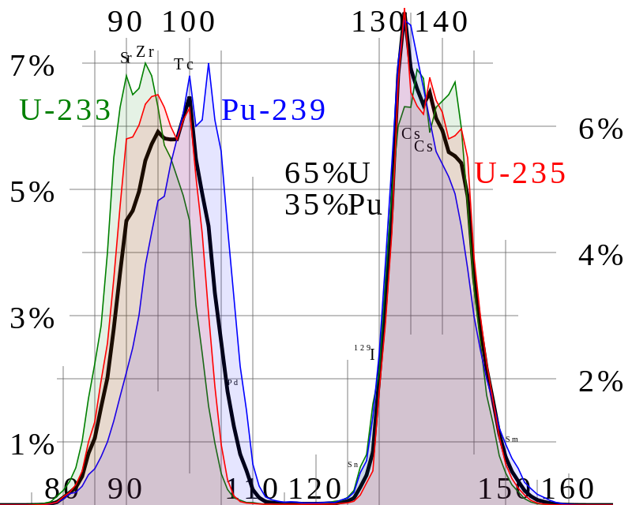
Fission Product Generation
Fission releases around 200 MeV
The fission fragments have 169 MeV of kinetic energy
2 to 3 neutrons with an average energy of 2 MeV
7 MeV of prompt gamma ray photons
The remaining energy is released by beta decay
Every fission product that is produced is now in the crystal lattice of the fuel, changing the microstructure

Slide 5
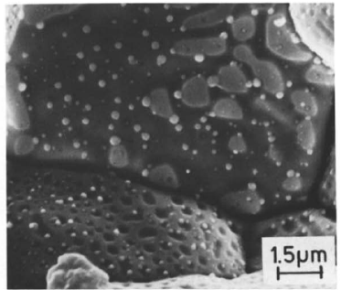
There are various types of fission products that form in the fuel
Soluble oxides (Y, La and the rare earths)
Dissolved in the cation sublattice
Insoluble oxides (Zr, Ba and Sr)
Form insoluble oxides in the fluorite lattice
Metals (Mo, Ru, Pd, and Tc)
Form metallic precipitates
Volatiles (Br, Rb, Te, I and Cs)
Exist as gases at high temperatures of the pellet interior
Also exist as solids at the cooler pellet exterior
Noble gases (Xe, Kr)
Essentially insoluble in the fuel matrix
Form either intragranular (within grain) voids or bubbles or intergranular (grain boundary) bubbles

Slide 6
All of the fission products impact the behavior of the fuel

Slide 7

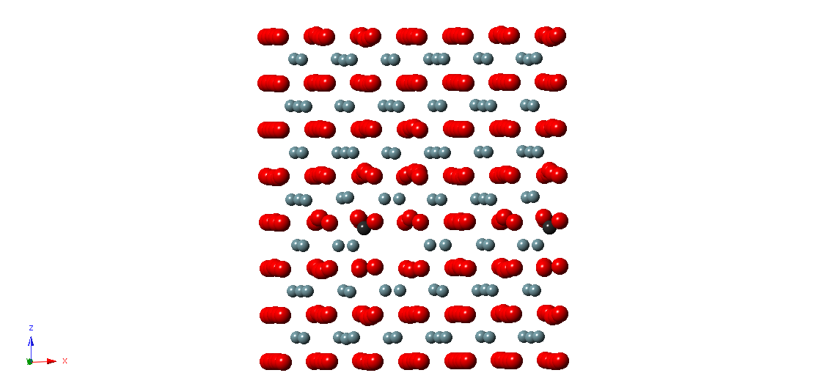
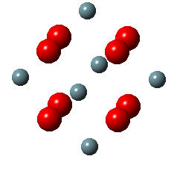
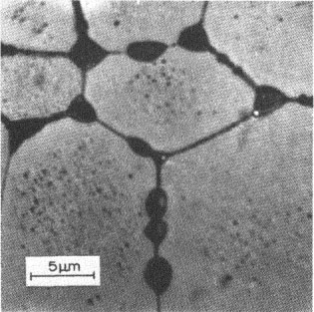
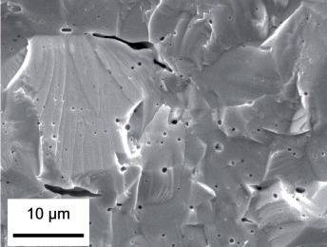
Fission Gas Release
Fission gases (Xe, Kr) are released in a process composed of three stages in UO2
Stage 1: Gas atoms are produced throughout the fuel due to fission and diffuse towards grain boundaries
Small intragranular bubbles form within the grains, but never get larger than a few nm radius due to resolution from energized particles
Gas atoms that don’t get trapped within the intragranular bubbles migrate to grain boundaries
Atoms forming a vacancy cluster

Slide 8
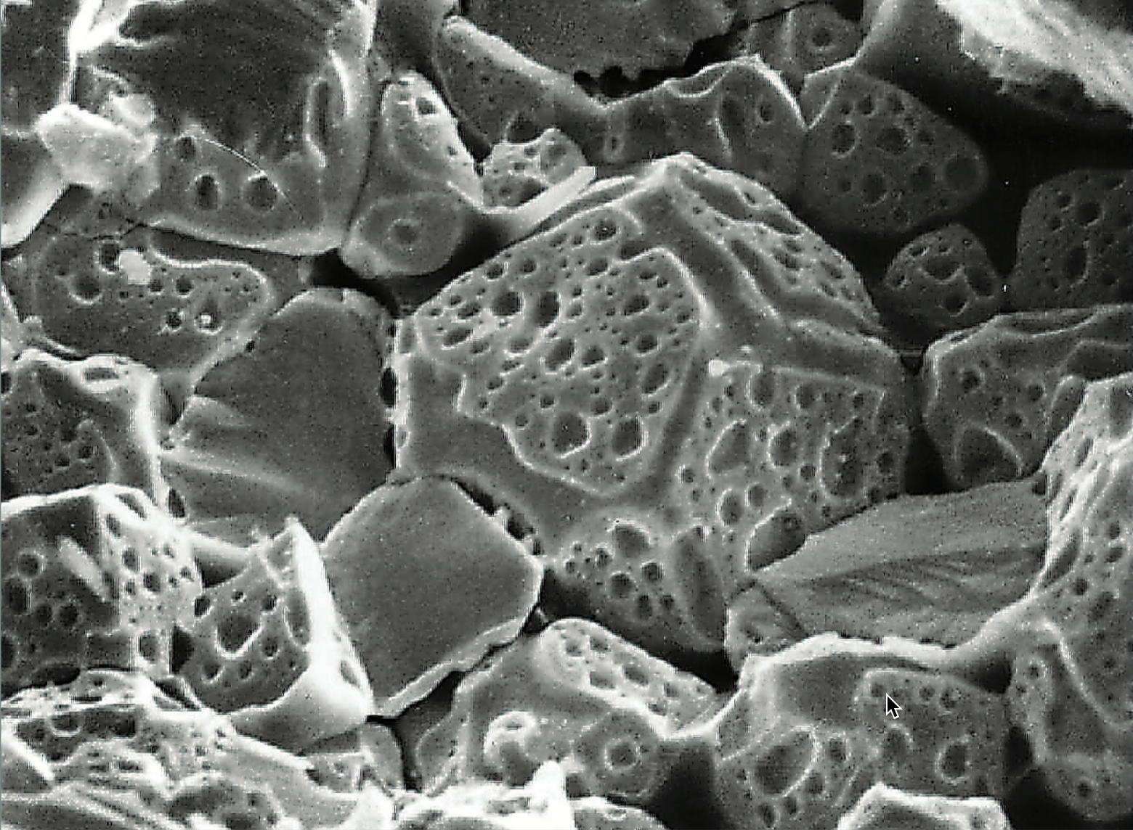
Fission Gas Release
Stage 2: Gas bubbles nucleate on grain boundaries, growing and interconnecting
Stage 3: Gas travels through interconnected bubbles to a free surface

Slide 9
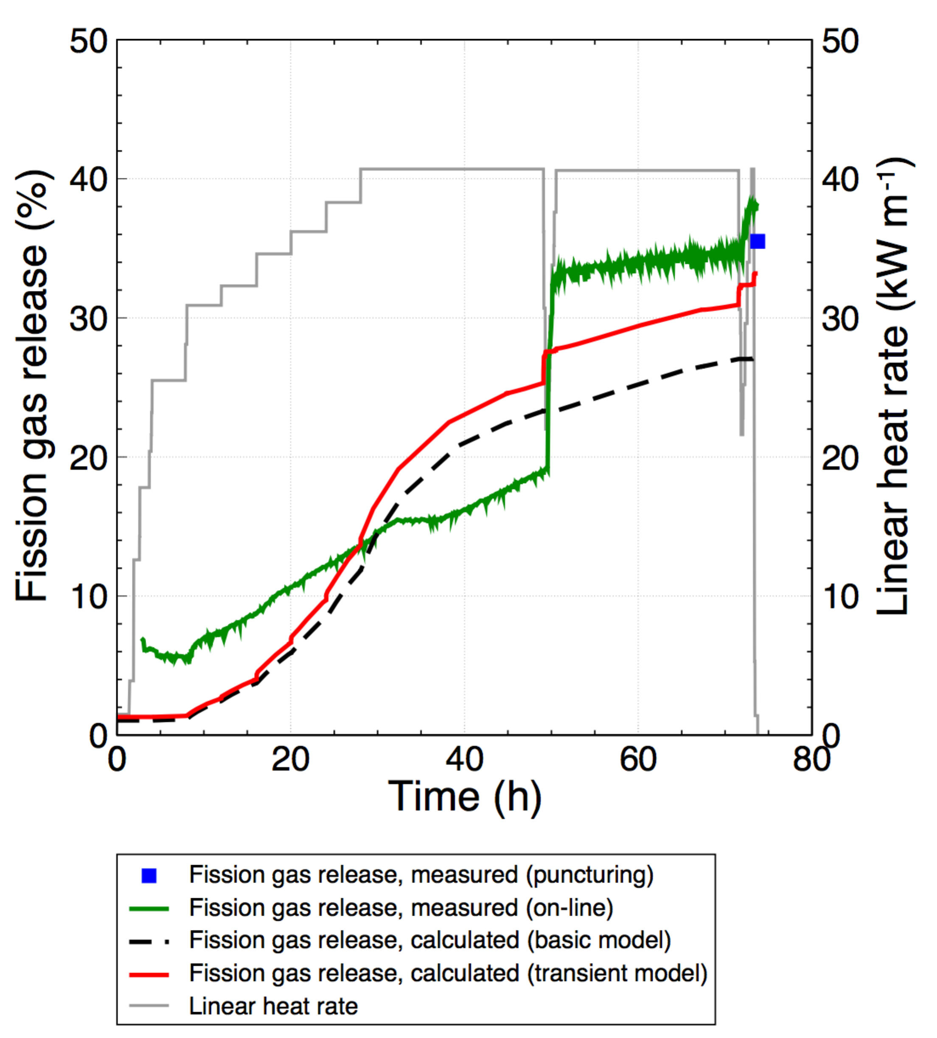
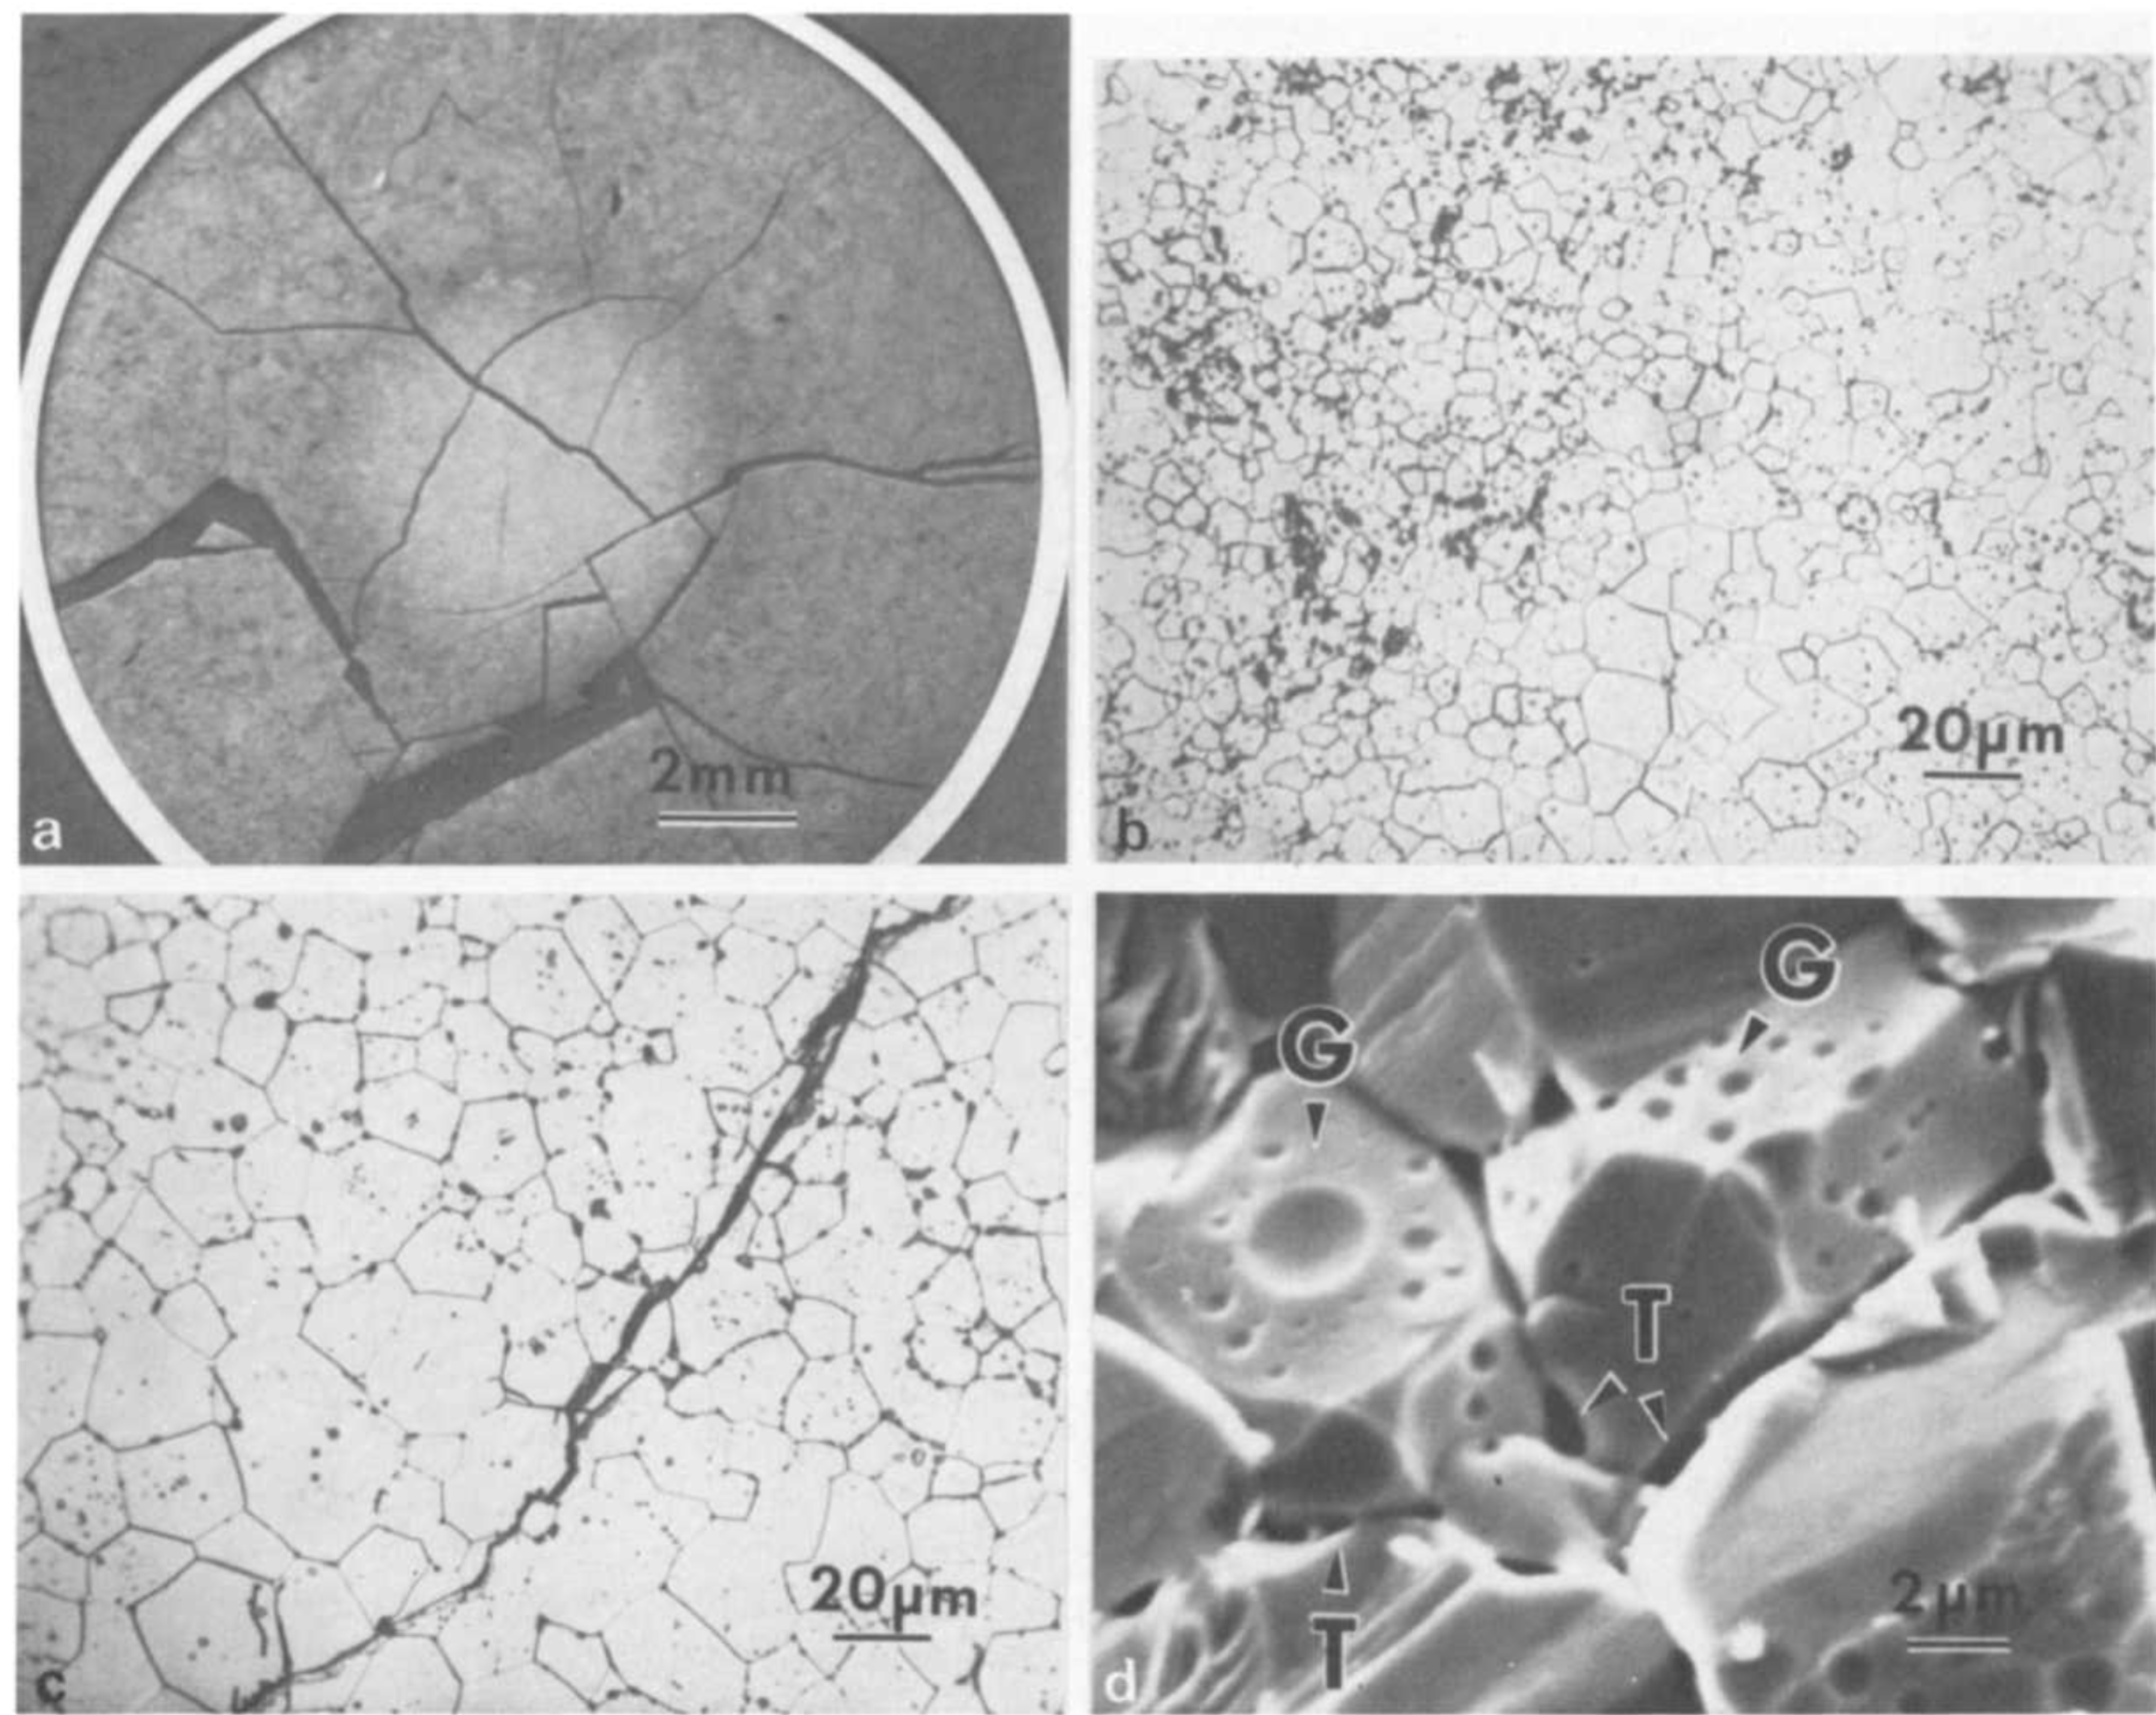
Fission Gas Release
Fission gas release also occurs due to mechanisms that don’t depend on diffusion
Release can occur to particle recoil and knockout at low temperature
It can occur due to fracture during rapid transients

Slide 10
Fission Gas Release
Released fission gas enters the gap and plenum, causing various problems
Xe and Kr have very low thermal conductivities, reducing the gap conductance
The plenum pressure increases
The volatile fission gases corrode the cladding
They are also radioactive and hazardous, causing problems when the cladding is breached
Fission gas release experiments:
Post irradiation annealing
Fuel is irradiated at low temperature
Fuel is then placed into a furnace and heated
Gas atom release is then measured
In-pile release
Gas release is measured during reactor operation
It is much more difficult than post-irradiation annealing
Total amount released is measured by puncturing cladding after irradiation
Release with time can be estimated using a pressure transducer inside an instrumented fuel rod

Slide 11
Fission Gas Release
Fission gas release models attempt to predict the rate at which gas is released from the fuel
To model fission gas release, ideally we must model all three stages of gas release
Diffusion of gas atoms to grain boundaries
Growth and interconnection of grain boundary bubbles
Transport of gas atoms through interconnected bubbles to free surfaces
The earliest models only considered Stage 1
Most models now consider stage 1 and 2
There are no models that consider all three stages, but some are under development

Slide 12
Booth Model
The Booth model is the earliest model of fission gas release and only considers stage 1
A grain is considered as a simple sphere
Gas atoms are released at the grain boundary
The model solves the diffusion equation in 1D spherical coordinates
Assumptions
c_{g}(r, t)
All grains are spheres of radius a
D is constant throughout the grain
Gas is produced uniformly throughout the grain
Gas is released once it reaches the grain boundary
Release
Gas atoms
Grain boundary
ICs and BCs
c_{g}(r, 0) = 0
c_{g,r}(0, t) = 0
c_{g}(a, t) = 0 (release)

Slide 13
Modeling post-irradiation annealing
The initial gas concentration is c_{g}⁰
No gas is produced
Solving this equation tells us the value of c_{g} at any radius or time
However, we want to know the fraction of gas atoms that have made it to the grain boundary
We use the flux at the grain boundary
Release
Gas atoms
Grain boundary
ICs and BCs
c_{g}(r, 0) = c_{g}⁰
c_{g,r}(0, t) = 0
c_{g}(a, t) = 0 (release)

Slide 14
Solving the Booth Model
This equation is solved using a Laplace transform after nondimensionalization
Will not go through the derivation (shown in Olander)
τ = D x t / a²
Release
Gas atoms
Grain boundary
τ < π⁻²
τ ≥ π⁻²

Slide 15
Booth Example
For a diffusion coefficient for Xe of D = 8e-15 cm²/s, what fraction of the fission gas trapped in an post-irradiation annealed fuel pellet has escaped after one hour? It has an average grain size of 10 microns
D = 8e-15 cm²/s
a = 10e-4 cm
t = 3600 s
Which f? τ = D x t/a² = 2.88E-4 < π⁻² = 0.101
f = 6*sqrt(8e-15*3600/(pi*(10e-4)^2)) – 3*8e-15*3600/(10e-4)^2 = 0.0181

Slide 16
Different expressions for fission gas release
Given the data from the previous example, can plot both
τ < π⁻²
τ > π⁻²

Slide 17
Modeling in-pile release
The initial gas concentration is 0
Gas is produced due to fission, where y is the chain yield (y = 0.3017 for Xe and Kr) and the fission rate
Gas can also decay, where λ is the decay constant
If we only consider stable stable products, λ = 0
For in pile release, the fraction is equal to
After solving with with a Laplace transform
The total gas production is gas atoms/cm³
Release
Gas atoms
Grain boundary
ICs and BCs
c_{g}(r, 0) = 0
c_{g,r}(0, t) = 0
c_{g}(a, t) = 0 (release)

Slide 18
Example
For a diffusion coefficient for Xe of D = 8e-15 cm²/s, what fraction of the fission gas trapped in an in-pile fuel pellet has escaped after one hour? It has an average grain size of 10 microns.
D = 8e-15 cm²/s
a = 10e-4 cm
We have a short time (t=3600 s), so we can use:
f = 4*sqrt(8e-15*3600/(pi*(10e-4)^2)) – 3/2*8e-15*3600/(10e-4)^2 = 0.0121

Slide 19
Gas release
We have calculated the fraction, but how much gas was actually released?
Consider 3% enriched UO₂ with a thermal fission cross section of U-235, σ_{f235} = 570 barns or 570 × 10⁻²⁴ cm² and a density of UO2, ρ_{U} = 10.97 g/cm³.
What would be the number of fission gas atoms released after one hour with a neutron flux of 3×10¹³ n/(cm² s) from a pellet of radius 0.5 cm and height 1.2 cm?
Molar mass of 3% enriched UO2: 235*0.03 + 238*0.97 + 2*16 = 269.9 g/mol
Atom density of U-235 = 10.97 x 1/269.9 x 6.022E23 x 1/1 x 0.03 = 7.34E20 atoms/cm³
First, we have to calculate the fission rate: Fdot = 7.34E20*570E-24*3e13 = 1.26E13 fissions/(cm³ s)
Next we calculate the total amount of fission gas produced
N_{FG} = y Fdot t = 0.3017*1.26E13*3600 = 1.36E16 fission gas atoms/cm³
Vol = π r² h = pi*0.5^2*1.2 = 0.94 cm³
NFG*Vol = 1.36E16*0.94 = 1.28e16 fission gas atoms
Finally we calculate the total amount of gas released using the fraction
f = 0.0121
Gas released = 0.0121*1.28e16 atoms produced = 1.55e14 atoms released

Slide 20
As time progresses, both the fraction released and the produced gas increase

Slide 21
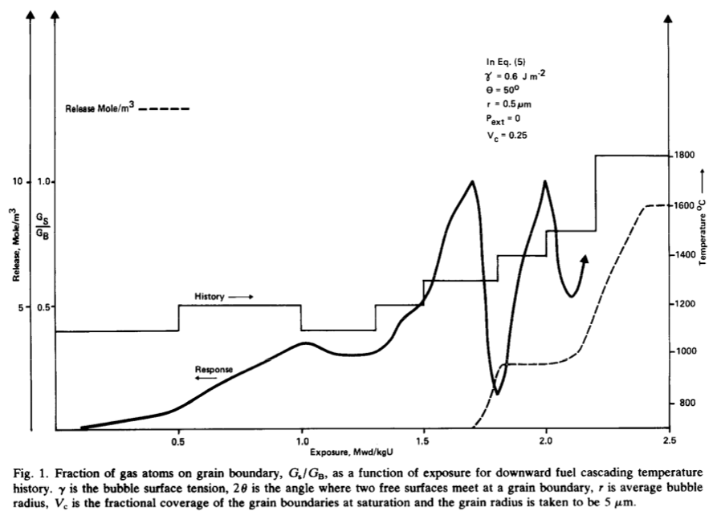
Forsberg-Massih model
The Booth model ONLY considers stage one of fission gas release
Two stage Forsberg-Massih mechanistic model
Considers intragranular diffusion diffusion to grain boundaries (stage 1)
Also, grain boundary gas accumulation, resolution back into grain, saturation (stage 2)
Assumes that once the bubbles on the grain face are interconnected, it is released (no stage 3)

Slide 22
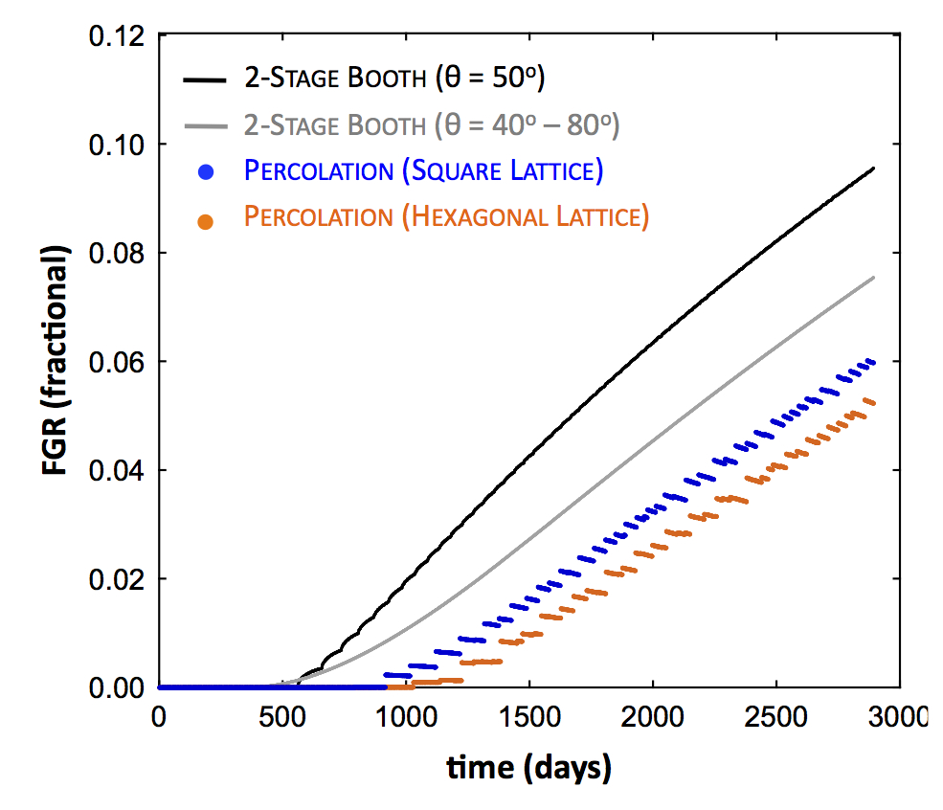
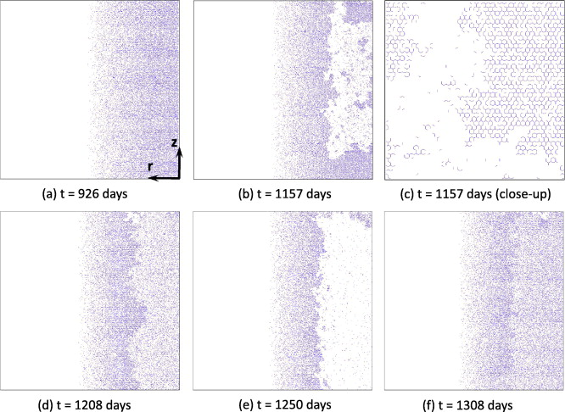
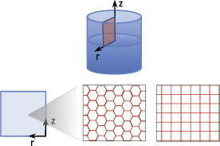
Forsberg-Massih model
2-stage F-M model over-predicts gas release because it neglects grain boundary bubble percolation (Stage 3)
Millett, Tonks, and Biner. JNM, 424.1 (2012): 176-182.

Slide 23
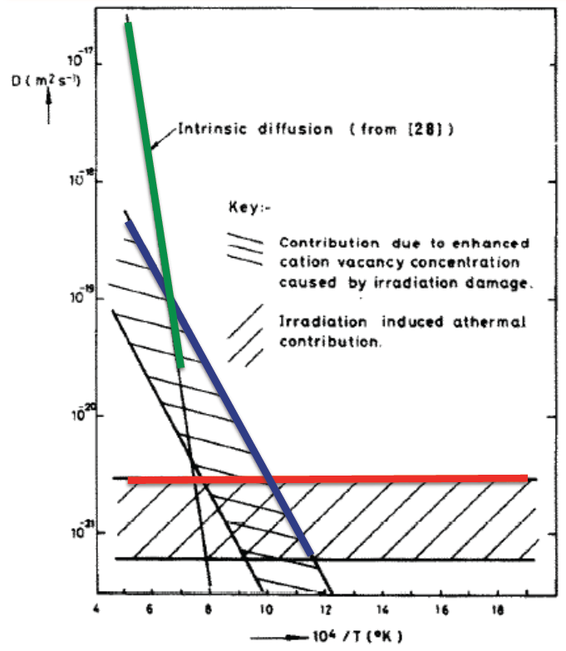
Gas diffusion
The diffusivity of the fission gas depends on temperature and on irradiation
Experimental data shows three different regimes for the diffusivity
D = D₁ + D₂ + D₃ cm²/s

Slide 24
Gas diffusion
The effective fission gas diffusivity is slower due to trapping by intragranular bubbles
As the gas atoms diffuse towards the grain boundary, some are trapped by the small intragranular bubbles
Some are later knocked out by energized particles (called resolution)
The effective diffusion constant depends on the trapping rate r_{t} and the resolution rate r_{r}

Slide 25
Summary
Fission products change the fuel behavior
Fission gas is released in three stages
Fission gas production and diffusion to grain boundaries
Grain boundary bubble nucleation, growth, and interconnection
Gas transport through interconnected bubbles to free surfaces
Fission gas release is measured using post-irradiation annealing and/or in pile experiments
Fission gas release models are used to understand fission gas experiments and to predict gas release for fuel performance codes
Spherical grain models predict a fraction of gas release for post-irradiation annealing or for in-pile gas release
Fission gas diffusivity behavior changes with temperature and fission rate

